Slide 1
Investigations in the #MeToo Era

Slide 2
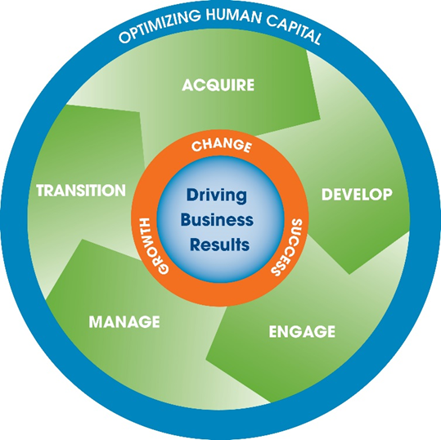
CCI Consulting
Established in 1988 as a Career Management firm offering Executive Search and Corporate Career Transition / Outplacement programs.
With 30 years of growth, we are now the largest privately-held Human Capital Management Consulting firm in Pennsylvania.
Today, our offerings encompass full end-to-end Lifecycle Human Capital Management Solutions.
Tier one, prime, diversity supplier Certified Woman-owned Business

Slide 3
CCI Consulting
Since 1988, we have helped more than 2,000 organizations, from Fortune 500 to small and large non-profits. A sample of relevant clients include:
Copyright © 2017 CCI Consulting. All Rights Reserved.

Slide 4
Fox Rothschild
Has grown to an 800-lawyer national law firm with 21 offices by focusing on client service and responsiveness.
For more than a century, Fox Rothschild attorneys have had a comprehensive understanding of the business and legal complexities with which nonprofit organizations must contend.
Fox clients include:
corporate fiduciaries (who administer charitable trusts and cemetery trusts), private and community foundations, supporting organizations, nonprofit corporations and associations, publicly supported charities, religious entities, social service agencies, community development corporations

Slide 5
Objectives
By the end of today’s session, you will be able to:
Assess the current state of your workplace
Identify what behaviors to address
Define steps employers should take to investigate
Take steps to increase awareness around respectful behavior and create a workplace culture that minimizes problems from occurring in the first place
Notes:
Read through objectives

Slide 6
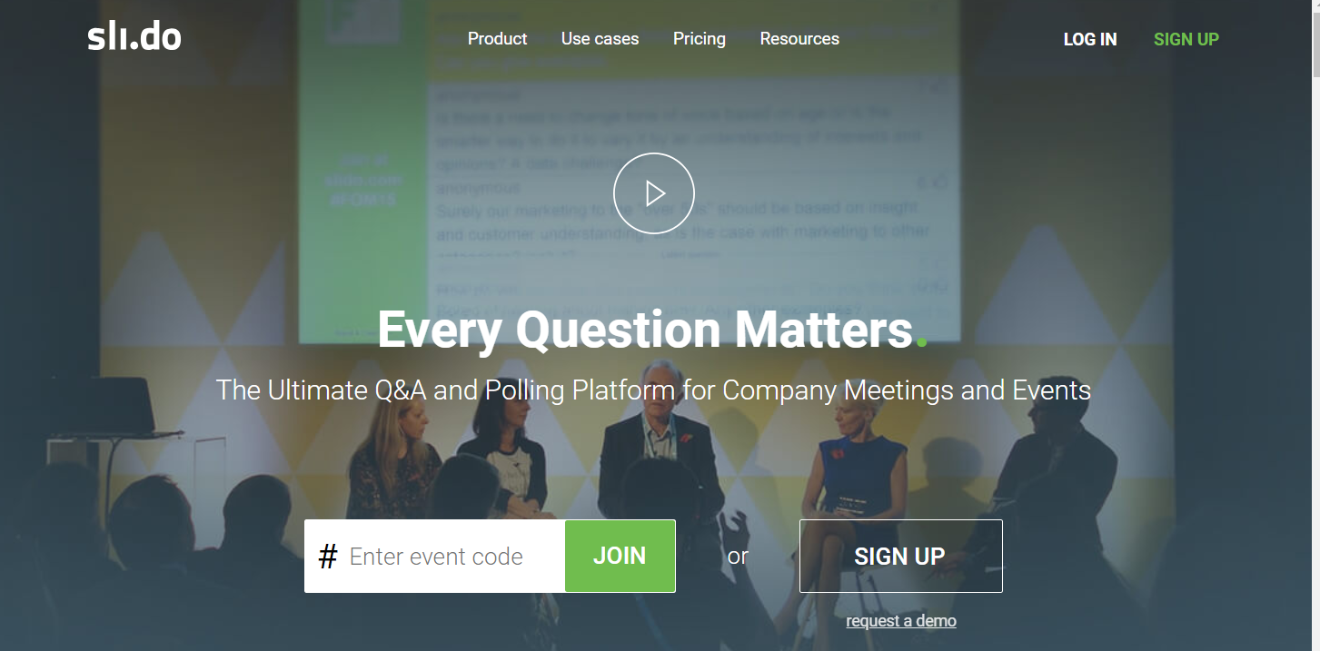
In a Word…
From your phones, go to the following website: www.slido.com
Enter the Event code Z281
Respond to the question prompt
Notes:
5-7 minutes
*ensure that you have internet access so you can display their results in real time from your computer!*
Participants will access the website in step 1 from their Smartphones
Enter event code on slide
Respond to question prompt
Question prompt is: In one word, what does a “Respectful Workplace” mean to you? Be prepared to discuss
Participants are directed to a live poll where once they respond, their answers will display on screen in a Word Cloud format (good for larger groups)

Slide 7
Current State
Notes:
*Placeholder to discuss current state*
This slide is intended to be the backdrop for talking about the current state of affairs and why this topic is so important.
When working with your employees it is important to remember that most people have good intentions and fail to recognize the impact on others.

Slide 8
Video – scenario for interactive discussion
youtube link:
https://www.youtube.com/watch?v=H5owCNvik0E

Slide 9
Why Does a Respectful Workplace Matter?
It’s the LAW…
It is the right thing to do and it’s about ensuring you are doing what is right
Disrespect…
It can be an overt action by a manager or someone with power/authority
It creates a hostile work environment
It is often subtle behavior

Slide 10
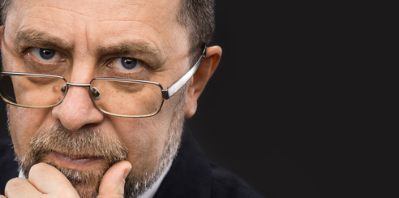
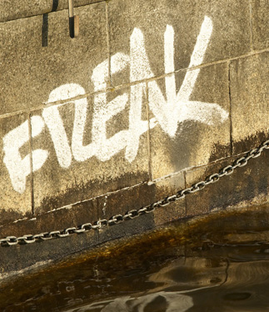
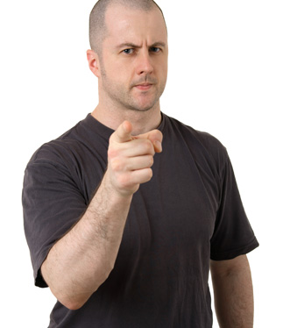
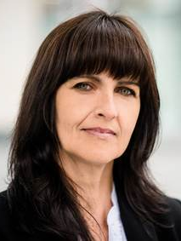
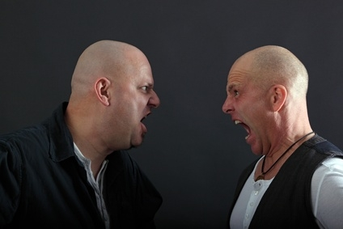
Harassment- Where Do You See it?
Tangible employment action
Verbal harassment
Non-verbal harassment
Sexual harassment

Slide 11
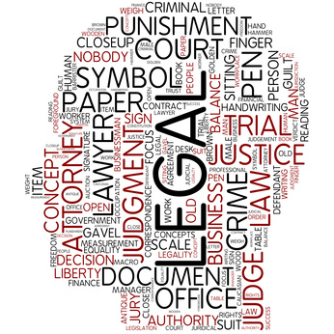
Harassment and the Law
Examples:
Title VII Civil Rights Act of 1964
State Law
Equal Employment Opportunity Commission (EEOC)
Americans With Disabilities (ADA)
Genetic Discrimination Act
Pregnancy Discrimination Act
Others...
Notes:
1 minute

Slide 12
Scenario - How Would You Investigate This?
You receive notice from your HR Generalist that there has been an anonymous complaint.
The caller refuses to give his identity or location, but says that he has been employed for a little over a year.
The caller advises that his manager, Matt, is treating him unfairly and that he is playing favorites with other employees. He gives a few examples of the favoritism shown to other employees, including that he is constantly written up for being late but his co-workers are not. He specifically complains that his co-workers Steve S., Charnelle Jackson, and Misty or Kristy (he’s not really sure of the name) are constantly late and not disciplined. He also notes that Kristy regularly goes to lunch with Matt and they are often seen huddled together and giggling. He says he overheard Charnelle make a comment to Kristy that “even if he was paying for my lunch, I wouldn’t want to go.”
Notes:
Table discussions

Slide 13
The Mistakes of Others
“I didn’t know this was going on.”
Novartis - $250 million punitive damages for gender discrimination (class action)
Coca-Cola - $192 million for race discrimination (class action)
SUPERVALU - $3.2 settlement for leave discrimination (class action)
UBS - $29 million for gender discrimination (individual claim)
AT&T- $5 million for religious harassment (individual claim)
Catholic Healthcare West Sacramento, California - $168 million for gender harassment (individual claim)
“We have strict policies against this kind of behavior.”
“That was not authorized.”

Slide 14
The Mistakes of Others
Tavis Smiley - Commentator
Heath Evans – NFL Player
Kevin Spacey - Actor
Louis C.K. - Comedian
Jeffrey Tambor – Actor
Andrea Ramsey – Democratic Candidate
Linda Sarsour – Women’s March Founder
Marshall Faulk – NFL Player
James Levine – Conductor
Matt Lauer – News Anchor
Charlie Rose – TV Host
Glenn Thrush – NYT Reporter
Russell Simmons – Hip Hop Mogul
Al Franken – Senator
Notes:
1 minute
Note that there are women mentioned as well in this list

Slide 15
Consequences of Workplace Harassment
For the Organization
Loss of productivity
Bad publicity / image
Lawsuits
Increased turnover
Inability to attract / retain good employees
Costs to organization: training, hiring, etc.
Loss of business relationships
Lack of teamwork
Legal fees / settlement costs
Notes:
.

Slide 16
Consequences of Workplace Harassment
For the Employee
Isolation
Loss of reputation
Increased absenteeism
Negative impact on family
Job loss
Decreased self-esteem
Decreased morale
Loss of self-respect
Stress
Poor health
No trust
Loss of productivity

Slide 17
#MeToo Movement
Existed long before the national movement
Tarana Burke created a “Me Too” movement in 2007 to help victims of sexual harassment & assault
October 15, 2017, actress Alyssa Milano invited people to use #metoo hashtag
Many #MeToo headlines and media stories focused on wealthy and/or white women’s experiences
Overlooked point: sexual harassment victims can be/are men
Men filed nearly 17% of sexual harassment complaints with EEOC in 2016

Slide 18
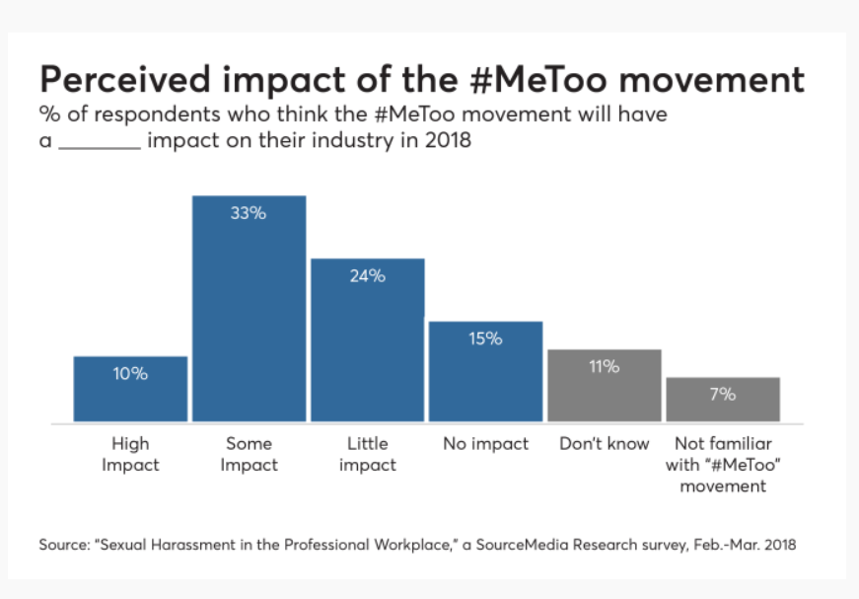
#MeToo Movement

Slide 19
Conducting an Investigation
Why Investigate?
Prevent future problems
Improve employee relations
Maintain a safe, legal, and productive work environment
Meet legal obligations and create an affirmative defense
Goals of Investigation
Find and correct problems
Address and end inappropriate behavior
Minimize disruption
Prevent retaliation

Slide 20
“P.E.R.C.s” of a Successful Investigation
Prompt: take reasonable care to promptly correct & prevent unlawful harassing behavior
Effective: provide proven & effective mechanism for reporting & resolving complaints of workplace harassment
Remedial: take appropriate remedial action under all circumstances
P
E
R
c
Confidential: employer must protect the confidentiality of employee claims to the best of its ability

Slide 21
Steps to Conducting an Investigation
Ensure Confidentiality
Select the Investigator
Create Plan for Investigator
Develop Interview Questions
Conduct Interviews
Make a Decision
Provide Interim Protection
Close Investigation
Source: SHRM “How to Conduct an Investigation”

Slide 22
The Rules of Documentation
Consistent
Timely
The facts, JUST the facts, and ONLY the RELEVANT facts!
Interviews
Investigations
Evaluations
Recommendations
There are NO “private files”

Slide 23
Internal vs. Third Party Investigation
HR Staff
Internal Security
Outside or nonlawyer, third-party
Team Approach
Legal counsel, in-house and outside
Source: SHRM “How to Conduct an Investigation”

Slide 24
Preventative Actions to Take
Corporate Culture
Education
Awareness
Trust
Engagement
Accountability
Alignment from Leadership on standards
Alignment begins to define the culture
Policies reinforce expectations

Slide 25
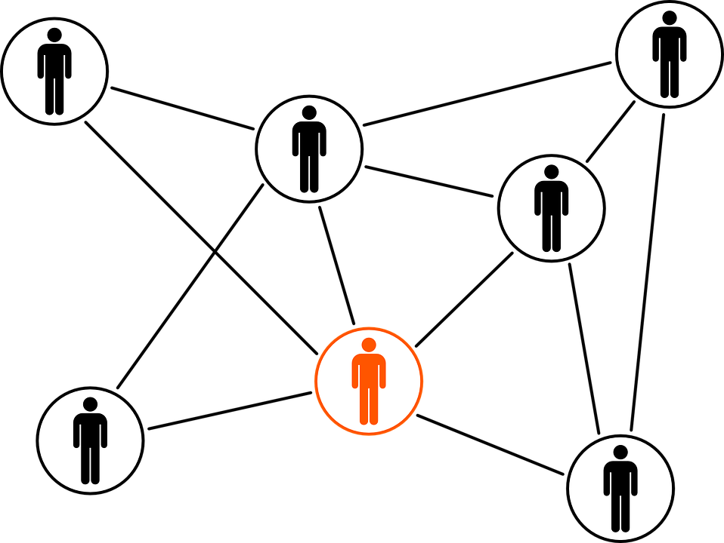
Your Role as a Leader & Employee
Don’t assume
Set the tone
Investigate
Be aware
Don’t ignore
Address conflict
Draw boundaries
Educate
Document
Communicate consistently
Value differences

Slide 26
Questions/ Comments

Slide 27
Contact Info
CCI Consulting
Susan McDonald Vice President Client Services smcdonald@cciconsulting.com O: 800.214.7537 Ext. 150 D: 267.254.4781 Fox Rothschild LLP Christina Stoneburner Partner | Labor & Employment Practice CStoneburner@foxrothschild.com O: 973.994.7551

