Slide 1
The Regulatory Review Process
in Pennsylvania
September 12, 2018
Mental Health Committee
Rehabilitation and Community Providers Association
Harrisburg, PA
James Smith & Corinne Brandt
Regulatory Analysts
Independent Regulatory Review Commission
www.irrc.state.pa.us

Slide 2
If you only remember one thing…
In most cases, regulations follow a two-stage review process:
  Proposed Regulation
    Comment, and
    Response
  Final Regulation
    Comment, followed by
    Vote
www.irrc.state.pa.us

Slide 3
Things to know about IRRC
An independent agency
Five commissioners, one each appointed by:
    Governor
    Senate President Pro Tempore
    Speaker of the House
    Senate Minority Leader
    House Minority Leader

Slide 6
Before Regulatory Oversight
The General Assembly had:
Enacted a large number of statutes
Given boards, commissions, departments, and agencies the authority to adopt rules and regulations to implement those statutes

Slide 7
Before Regulatory Oversight
Pennsylvania’s legislature found that this delegation of its authority resulted in regulations that:
  Did not conform to legislative intent
  Were not evaluated based on their cost benefit

Slide 8
Before Regulatory Oversight
The General Assembly determined that it must establish a procedure for oversight and review of regulations to:
  Curtail excessive regulation, and
  Require the executive branch to justify its exercise of the authority to regulate before imposing hidden costs upon the economy of Pennsylvania

Slide 9
Enactment of Regulatory Review Act
Establish a method for ongoing and effective legislative review and oversight to foster executive branch accountability
Provide for primary review by an agency with sufficient authority, expertise, independence and time to perform that function…IRRC
Provide ultimate review of regulations by the General Assembly
Assist the Governor, the Attorney General and the General Assembly in their supervisory and oversight functions
Encourage the resolution of objections to a regulation and the reaching of a consensus among the Commission, the Standing Committees, interested parties and Agencies

Slide 10
Present Day: Legal Framework
Administrative Code (71 P.S. § 232)
  Section 612 requires the Governor’s Office of Budget to prepare a fiscal note for proposed regulations indicating revenue loss or cost increase
Commonwealth Attorneys Act (71 P.S. §§ 732-101–732-506)
  Provides for the review of proposed and final regulations for form and legality by the Office of Attorney General and the Office of General Counsel
Commonwealth Documents Law (45 P.S. §§ 1102-1208)
  Provides for the publication of proposed rulemakings for public review and comment
Regulatory Review Act (RRA) (71 P.S. §§ 745.1– 745.14)
  Provides for the formal review of proposed and final regulations by the General Assembly and IRRC

Slide 11
What is a regulation?
“Any rule…promulgated by an agency under statutory authority….”
  Statutory authority: a law written and passed by an elected legislature and Governor
  Regulation:
      Under the authority of the statute
      Has the full force and effect of law
      Binding on the agency and regulated community
      Promulgated by an agency

Slide 12
What can regulations do?
Add, amend, or repeal a regulation
Implement legislation
Comply with a state or federal court decision
Clarify an existing regulation

Slide 13
Examples of Regulations Reviewed by IRRC
Intellectual Disability Terminology Update (#3137)
Core Assessment Standards (#2976)
Proposed Changes to Immunization Requirements (#3146 and #3147)

Slide 14
Regulation Examples

Slide 15
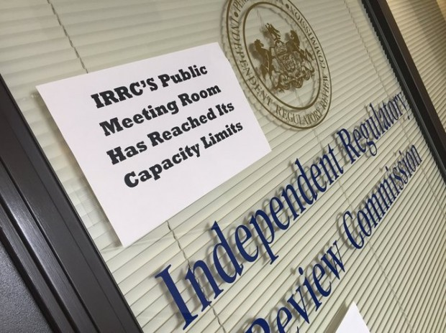
Regulation Examples

Slide 16
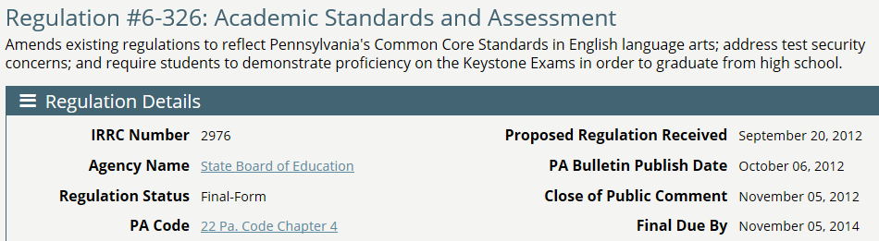
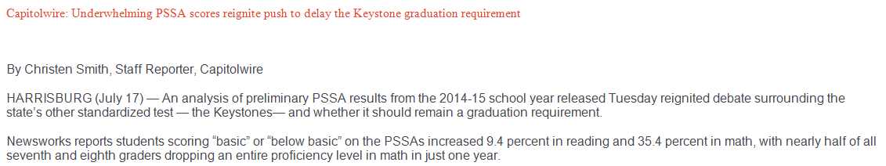
Regulation Examples

Slide 17
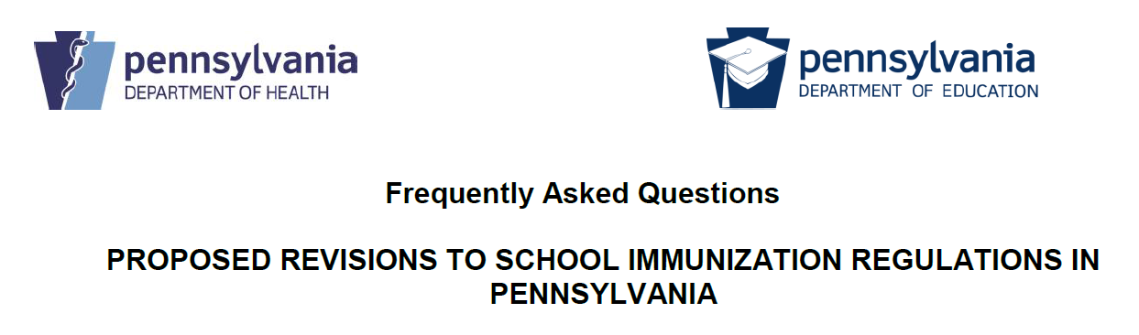


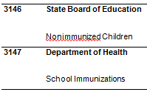
Regulation Examples

Slide 18



Other Examples
State Athletic Commission: Mixed Martial Arts “Ground and Pound” Rules (#2958)
DCNR: Ginseng Harvesting Regulations (#2991)
Gaming Control Board: Smoking in Licensed Facilities (Implementing the Clean Indoor Air Act) (#2731)
XX

Slide 19
Some Exceptions
Regulations from the Courts, Game Commission, and Fish & Boat Commission
Other Areas Specifically Exempted by Statute
  Initial Regulations Under Act 16 of 2016 (Medical Marijuana) – The Act provides for temporary regulations that are exempt from regulatory review
  Act 22 of 2011 (Omnibus Welfare Code Amendments) – Approved June 30, 2011; This statute specifically exempted from review regulations promulgated through June, 2012

Slide 20
Finding Out About Proposed Regulations
Stay in Contact with Agency/Department Staff
Visit IRRC’s website and subscribe to receive automatic notices regarding specific agencies, specific regulations, the posting of IRRC’s public meeting agendas
Review Governor’s Regulatory Agenda in February & July

Slide 24
Governor’s Regulatory Agenda

Slide 25
Two-stage Regulatory Review Process
In order for a regulation to become official, it must first go through the regulatory review process.
Two Formal Stages to the Process
    1. Proposed – Published in Pennsylvania Bulletin, Comments Submitted to Agency, followed by Agency Review, Response, and Amendments
    2. Final – Comments, IRRC Public Meeting

Slide 26
Proposed Regulation Steps
Proposed: Delivery to Legislative Reference Bureau, IRRC, and Standing Committees
  Reviewed by Attorney General, Budget Office, and Office of General Counsel
  Publication in PA Bulletin and minimum 30-day public comment period
  Review and comment period for the public, IRRC and Standing Committees

Slide 27
Proposed Regulation Review
Public Comments
  Comments from the public, trade associations, and members of the regulated community must be filed within the comment period – NO EXCEPTIONS
IRRC review
  Comments due 30 days from the close of the public comment period – NO EXCEPTIONS
  Scope of review limited to statutory criteria
  It is possible that IRRC will not issue comments
Standing Committees review
  Comments may be delivered any time before final-form regulation is delivered
  Scope of review is not limited to statutory criteria
www.irrc.state.pa.us

Slide 28
IRRC Criteria for Review
  Whether Agency has statutory authority to implement the regulation
  Whether the regulation is consistent with legislative intent
  Economic and fiscal impact on the public and private sector
  Protection of the public health, safety and welfare
  Clarity, feasibility and reasonableness of the regulation
  Whether the regulation is a policy decision requiring legislative review
www.irrc.state.pa.us

Slide 29
IRRC Criteria for Review
  Comments, objections or recommendations of a Standing Committee
  Compliance with the Regulatory Review Act and IRRC regulations
  Whether the regulation is supported by acceptable data
  Whether there is a less costly or intrusive alternative for small businesses
www.irrc.state.pa.us

Slide 30
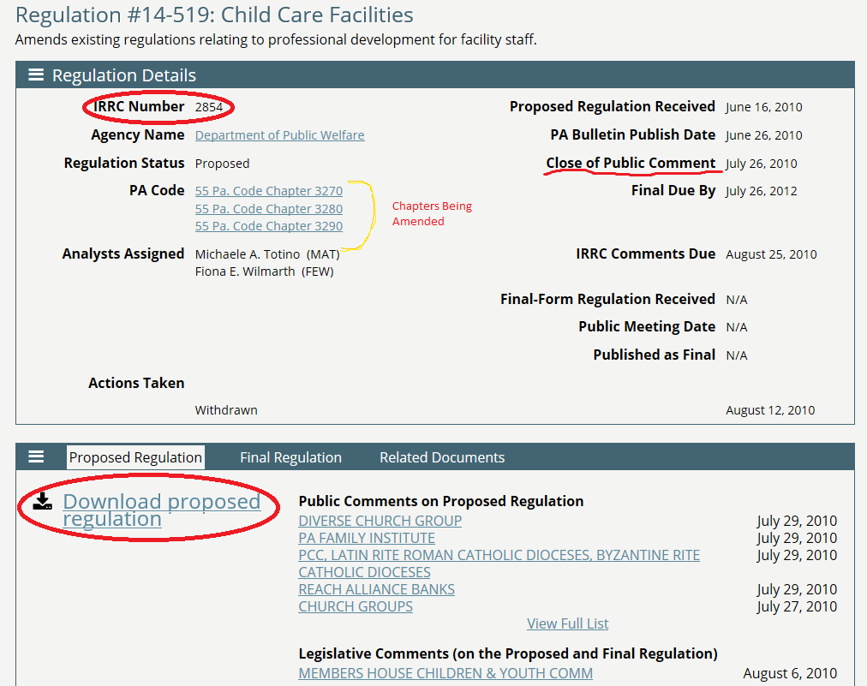

Slide 31
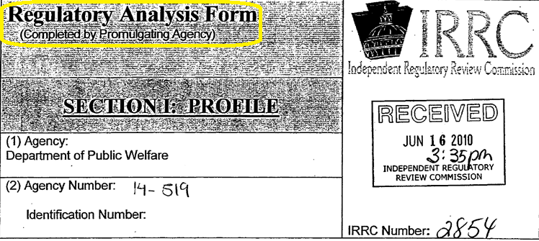
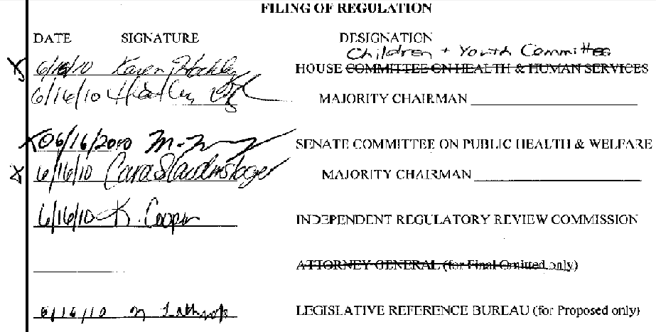
Proposed Regulations
www.irrc.state.pa.us

Slide 32
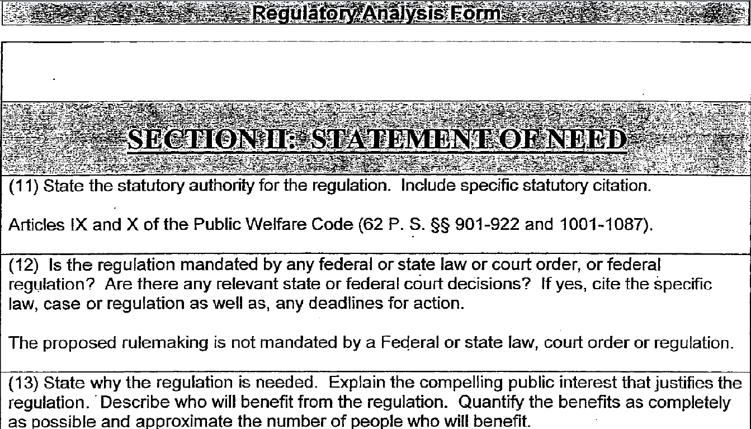
Proposed Regulations – Sample RAF
www.irrc.state.pa.us

Slide 33
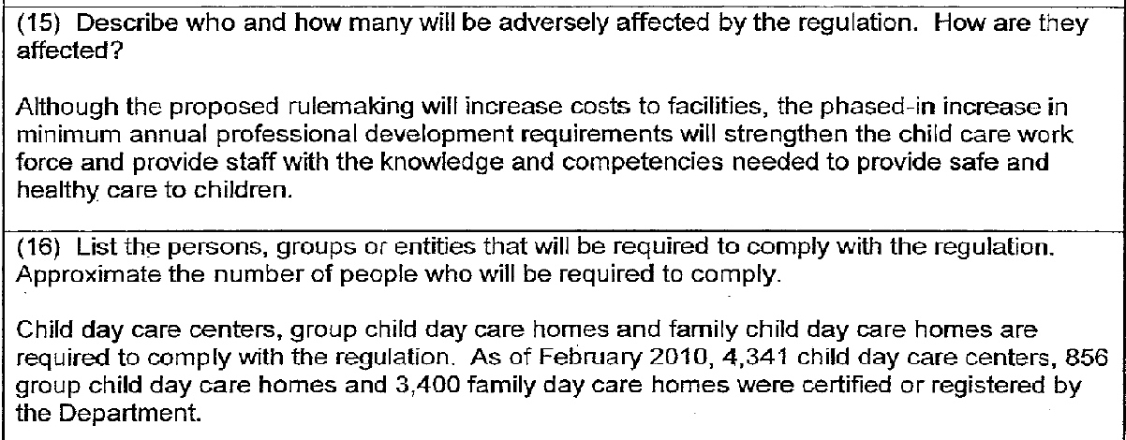
Proposed Regulations – Sample RAF
www.irrc.state.pa.us

Slide 34
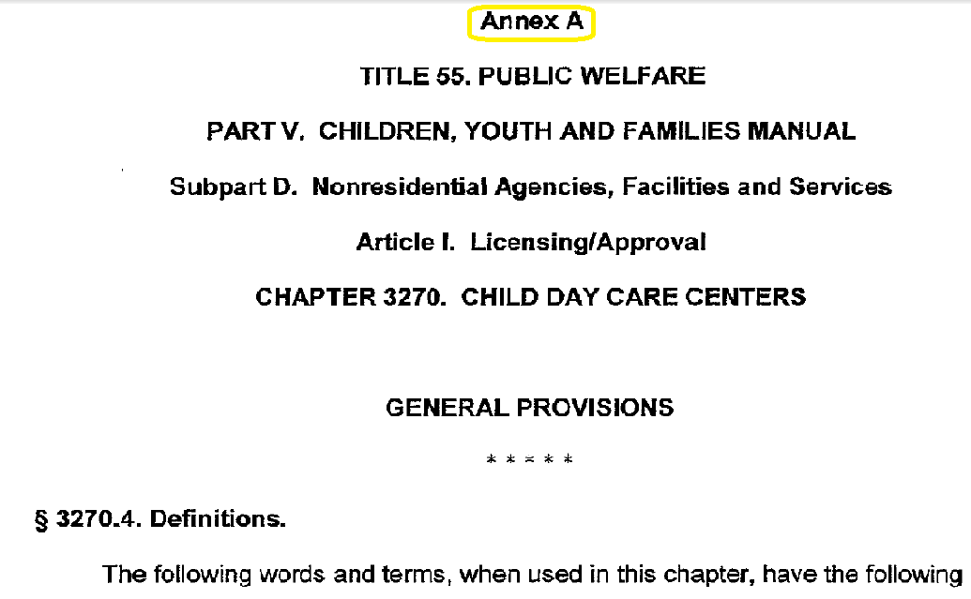
Proposed Regulations
www.irrc.state.pa.us

Slide 35
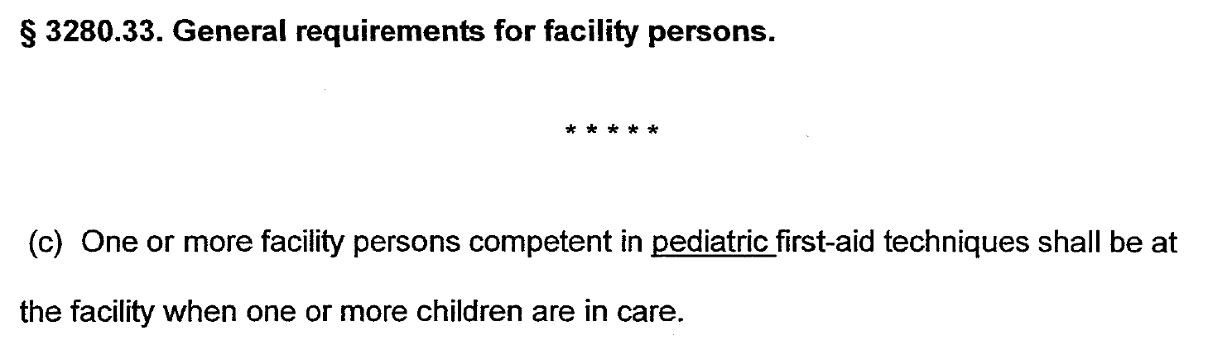
Proposed - Sample Annex Excerpt
www.irrc.state.pa.us

Slide 36
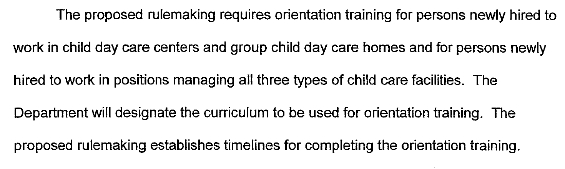
Sample Preamble Excerpt
www.irrc.state.pa.us

Slide 37
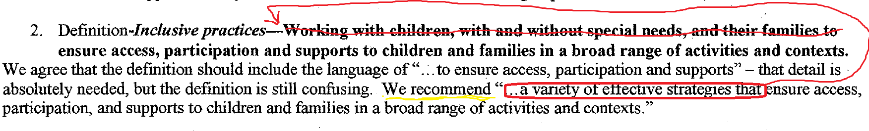
Review of Comments by Agency
www.irrc.state.pa.us

Slide 38
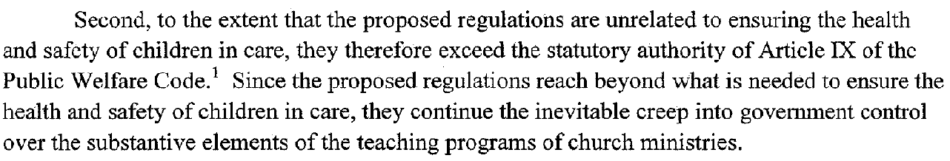
Review of Comments by Agency
www.irrc.state.pa.us

Slide 39
Review of Comments by Agency
During the two years that follow the close of the public comment period, the Agency:
  Reviews all comments received
  May convene stakeholder group(s)
  May make changes to proposed regulation
  May issue a draft of the final regulation or publish an Advanced Notice of Final Rulemaking
  Prepares the final-form regulation
  Prepares a comment and response document
  May decide not to submit the final-form regulation – end of process
www.irrc.state.pa.us

Slide 40
Final Regulation Timetable
Submission of final-form to IRRC and Standing Committees
(Within 2 years from close of public comment period)
Standing Committee action
(Up to 24 hours before IRRC public meeting)
IRRC public meeting
(Minimum 30 days from receipt of final-form regulation)
www.irrc.state.pa.us

Slide 41
Final Regulation
  Must include a response to all comments received
  New RAF and Annex are included with any updates and revisions
  Delivered to IRRC and the Standing Committees
  Scheduled for consideration at IRRC’s next public meeting that is at least 30 days from delivery of the regulation

Slide 42
IRRC Public Meeting
Meeting – not a hearing
Consideration of a regulation
  Staff provides summary of the regulation
  Agency opening remarks
  Public comments
  Agency response
  Commissioners motion and vote on regulation
www.irrc.state.pa.us

Slide 43
Public Participation
  Final stage
  Interested parties may submit comments to IRRC prior to IRRC’s public meeting
  Attend IRRC’s public meeting
  Speak in support of or opposition to the regulation at IRRC’s public meeting

Slide 44
IRRC’s Review Criteria
IRRC review is based on RRA criteria:
Whether the agency has statutory authority to implement the regulation
Whether the regulation is consistent with the legislative intent
Notes:
The RRA established these two criteria as the most important. If IRRC determines that the regulation satisfies these criteria, then IRRC must determine…

Slide 45
IRRC’s Review Criteria
Is the regulation in the public interest?
Determination based on the criteria:
Economic or fiscal impacts
Protection of the public health, safety and welfare and the effect on Pennsylvania’s natural resources
Clarity, feasibility and reasonableness

Slide 46
IRRC Public Meeting
If IRRC approves a regulation, the Agency may
  Deliver to Office of Attorney General for review
  Deliver to Legislative Reference Bureau for final publication
www.irrc.state.pa.us

Slide 47
IRRC Public Meeting
Deemed to be approved if:
  IRRC issued no public comments on proposed regulation
  and
  Agency did not make any changes to the regulation from proposed to final
  and
  No concerns raised by Standing Committees
www.irrc.state.pa.us

Slide 48
If a Regulation is Approved
Most regulations become effective on the date of publication, which means…
the regulation has successfully gone through the regulatory review process and, upon publication, has the full force and effect of law.

Slide 49
IRRC Public Meeting
If IRRC disapproves a regulation, the Agency may
  Redeliver the final-form regulation with revisions
  or
  Redeliver the final-form regulation without revisions
  or
  Choose not to redeliver the regulation
www.irrc.state.pa.us

Slide 50
If a Regulation is Disapproved
Ultimately, IRRC cannot stop the promulgation of a regulation.
IRRC can disapprove a regulation twice, but the General Assembly must act to stop a regulation using the concurrent resolution process.

Slide 51
Barring a Regulation
Standing Committee reports out a
concurrent resolution
Bicameral action
Presentment to Governor
(Legislature must override Governor’s veto)
If concurrent resolution is not successful, Agency has sole discretion as to whether to promulgate the regulation

Slide 52
Final-omitted & Emergency Regulations
Not published as proposed in the PA Bulletin
No comment period other than time before IRRC consideration
Enters the process at the final stage
Delivery to IRRC and Standing Committees
Regulation is placed on agenda of IRRC’s next public meeting (which occurs no less that 30 days after delivery)

Slide 53
Final-omitted & Emergency Regulations
Final Omitted
Permitted when:
  Comments from public are not appropriate, necessary, or beneficial
  All persons subject to the regulation are named or given personal notice
  Notice is impractical, unnecessary, or contrary to public interest
Attorney General Reviews Prior to Delivery
Emergency Certified
Governor or Attorney General certifies that it is necessary to respond to an emergency
Takes effect immediately
If disapproved by IRRC or a Committee, remains in effect for another 120 days

Slide 54
Sine Die Adjournment
Current session ends either:
  November 30th at midnight
  or
  Both chambers adopt a sine die adjournment resolution
Start of new session for regulatory purposes:
  4th Monday in January of the next year
  or
  Both chambers have designated standing committees
www.irrc.state.pa.us

Slide 55
Proposed Regulations During Sine Die
Agencies may not deliver proposed regulations to Standing Committees, but may deliver to IRRC and Legislative Reference Bureau
Following sine die adjournment, agencies may deliver proposed regulations to the Standing Committees:
  On or after the 4th Monday in January
  or
  When both Standing Committees have been designated, but no later than the 2nd Monday after committee designations are published in the PA Bulletin
www.irrc.state.pa.us

Slide 56
Final Regulations During Sine Die
Agency delivers final regulation before sine die adjournment, but Standing Committee minimum 20-day review period is not completed before sine die
  Agency must resubmit final regulation to IRRC and the Standing Committees
  By the 4th Monday in January
  or
  When both Standing Committees have been designated, but no later than the 2nd Monday after committee designations are published in the PA Bulletin
www.irrc.state.pa.us

Slide 57
Final Regulations During Sine Die
Two-year period for final regulation expires after sine die adjournment
Agency must resubmit final regulation to IRRC and the Standing Committees
  By the 4th Monday in January
  or
  When both Standing Committees have been designated, but no later than the 2nd Monday after committee designation are published in the PA Bulletin
After sine die adjournment, agencies may not deliver final regulations until after the start of the next legislative session
www.irrc.state.pa.us

Slide 58
Pennsylvania’s
Regulatory Review Process
More information about Pennsylvania’s Regulatory Review Process
Follow us on Twitter: PA_IRRC
Meeting videos available on Vimeo: IRRC PA
Use IRRC’s website to subscribe to receive automatic notices regarding specific agencies, specific regulations, the posting of IRRC’s public meeting agendas
  –

Slide 59
More information about Pennsylvania’s regulatory review process
Questions?

